Slide 1
Group Design, Selection, and Screening
By: Kelley Crowley
April 25, 2024
CNL 520
Grand Canyon University

Slide 2


Group Type:
Children of Addicts

Slide 3
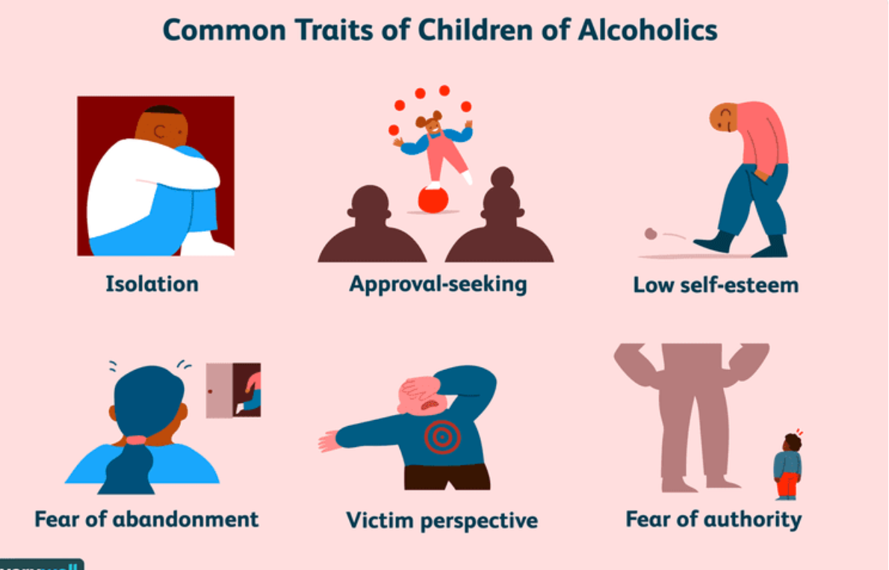
Why I chose this Group
Personal:
Family History of Alcohol Addiction
Little Resources Available
Personal Risk of Addiction
Generational Addiction
Notes:
Children of addicts often have feelings and needs of the children that are usually ignored. With certain parents, the child can typically live in fear and have unpredictable behavior. These children can be emotionally confused and frustrated while also embarrassed to entertain friends at their home. These children go through this at such a young age that can leave them emotionally confused and leave them extremely codependent who have little resources.

Slide 4

Continuation of Why I chose the group
Students:
Children:
Most impacted
Low grades
Risk for addiction
Closed off to relationships
Damage
Notes:
Children of addicts are typically the most impacted by their parent's addiction. As a result of this parent's addiction, the client will have low grades, a constant risk for addiction, and damage and close off to relationships. Lastly, these children can suffer from significant damage from a young age through well into their older adult lives.

Slide 5
Population
Low income students
High school/Late middle school students ages 14-18
Children ranging from the ages to 6 to 11.
Notes:
Children with parents who are addicts are most often low income students. Typically, these children are in high school or late middle school ranging from the ages of fourteen to eighteen. There are also children who are children of addicts which can be the ages of six to age eleven.

Slide 6

Cultural Populations and Considerations
Values and Beliefs
Family Relationships
Shift in family dynamics
Collaboration
Cultural Competence
Notes:
There are cultural populations and considerations to take note of and be aware of as future counselors which are of course the client's values, beliefs, family relationships, family dynamic shifts, collaboration, and cultural competence. It is important for the counselor to be completely ethical when dealing with these issues for the clients.

Slide 7

Number of Sessions
About 18-20 sessions
60 minutes per session
Time to build rapport
Notes:
The number of sessions that counseling a group of children would take includes about eighteen to twenty sessions at about sixty minutes per session. This higher number of sessions allows the therapist time to build rapport, go through all the counseling sessions, and give each client the time to heal.

Slide 8
Number of Participants
About 8-10 per group
Variation dependent on school and number of students
Smaller group to help populations
Encourages more comfort in the group
Allows counselor to focus more on the individuals with a smaller group
Notes:
The number of participants in a session should be about eight to ten per group in order to get the best possible outcome. The variation of clients in the group is a variation depending on the school and number of students. Having smaller groups can help comfort smaller groups while also allow the counselor to focus more on each member

Slide 9

Counseling Goals
Setting Goals
Learning Boundaries
Coping Skills
Emotional Support
New Outlook on life
Improving Relationships
Development
Notes:
Each client should get the most possible out of counseling in order to heal. Counseling goals should include setting goals, learning one's boundaries, implementing coping skills individually and in the group, learning emotional support, gaining a new outlook on life, improvement in relationships (romantically and platonically), and development. Setting each of these goals can increase success in session which can be applied to the client's life

Slide 10

Ethical Considerations
Informed consent
Confidentiality
Judgement-free
Non-discrimination
Bias Free
Clear communication
Notes:
In every session, there are ethical considerations that need to be followed for the counselor to practice in not only an ethical but a safe manner. These ethical considerations are set forth by the ACA. These ethical considerations include informed consent, confidentiality, judgment-free, non-discrimination, bias-free, and have clear communication for the duration of the session.

Slide 11
Theoretical Approaches
Family Systems Theory
Cognitive Behavioral Therapy
Group therapy
Psychotherapy
Humanistic therapy
Notes:
There are different theoretical approaches which include cognitive behavioral therapy (CBT), family systems theory, group therapy, psychotherapy, and humanistic therapy. Each of these theoretical approaches is not only beneficial to a typical client but can be extremely beneficial to children of addicts as they have anxiety, depression, PTSD, and struggle with their own identity.

Slide 12
Screening Questions
Tell me about yourself (Name, Age, and where you are from)
What are your likes and dislikes?
What are your hobbies and interests?
What do you wanna do or be when you grow up?
Tell me three positive things about yourself
What is something you wish to change about yourself?
Do you have fears about being in this group?
What is something positive you can take from the group?
How do you feel about seeing your parent’s addiction?
What are coping strategies that you could use to help get through this?
What is your perception of the group?
Notes:
Tell me about yourself (Name, Age, and where you are from)
What are your likes and dislikes?
What are your hobbies and interests?
What do you wanna do or be when you grow up?
Tell me three positive things about yourself
What is something you wish to change about yourself?
Do you have fears about being in this group?
What is something positive you can take from the group?
How do you feel about seeing your parent’s addiction?
What are coping strategies that you could use to help get through this?
What is your perception of the group?

Slide 13
Conclusion
Learn to control emotions
Grow up fast
Codependent on substance
Poor decision making skills
Lack of trust
Zero stability
Resources available
Notes:
In conclusion, children of addicts learn to control and limit their emotions, have to grow up fast mentally and emotionally, become codependent on substances, lack trust, have poor decision-making skills, and a lack of resources available to them. Counseling is one of the only sources of help for children of addicts as it creates lasting help and solutions for them.

Slide 14
References
Corey, M. S., Corey, G., & Corey, C. (2018). Groups: Process and practice, 10th ed. Cengage Learning.
Bukhari, F., AlKetbi, R., Rashid, S., Ahmed, A., & Shakir, K. (2021). Challenges in dealing with involuntary clients. Cogent Social Sciences, 7(1), 1918856.
Petkus, Andrew J., and Julie Loebach Wetherell. “Acceptance and Commitment Therapy with Older Adults: Rationale and Considerations.” Cognitive and Behavioral Practice, vol. 20, no. 1, Feb. 2013, pp. 47–56, https://doi.org/10.1016/j.cbpra.2011.07.004.
Psychology Today. “Person-Centered Therapy .” Psychology Today, 2016, www.psychologytoday.com/us/therapy-types/person-centered-therapy.
Schimmel, C., J., Jacobs, E., & Adams, J., R. (2015). Involuntary members in a group. In M. A. Stebnicki, The Professional Counselor’s Desk Reference (2nd ed.). Springer Publishing Company. https://search.credoreference.com/articles/Qm9va0FydGljbGU6NDI0MDA5OQ==?aid=96349

